Slide 1
Physical Memory Organization

Slide 2
Physical Memory Organisation
Memory = 1M bytes
Odd memory bank(512 Kb) and even memory bank (512 Kb)
1 byte of data with even address is transferred on D7-D0.
1 byte of data with odd address is transferred on D15-D8.
BHE and A0 are used for selection of odd or even or both memory banks.
Instruction is fetched from memory as word (2 bytes).
Both bytes may be operands
Both bytes may be opcode bytes
One of the bytes may be opcode and other may be data
The above is taken care of by decoder circuit.
The output of decoder ckt acts as inputs to the timing and control signals
Timing and control unit derives all the signals required for instruction execution

Slide 3
To read or write a complete word from or to memory, if it is located in the even address only on read or write cycle is required.
If the word is located at an odd address, first memory read/write cycle is needed for accessing the lower byte
Second memory cycle is needed for accessing the higher byte
2 memory cycles are required if the word is located at an odd address
For efficiency the stack should be initialised at even address.

Slide 4
16-bit processor can access 2 bytes of data in 1 memory or IO read / write operation
Commercially available - 8 bit memory chips
So 2 memory chip with parallel access of 16 bit data from both the chips
Bits D0-D7 of 16 bit data will be transferred over D0-D7 (lower byte) of 16-bit data bus to/from 8 bit memory
Bits D8-D15 of 16 bit data will be transferred over D8-D15 (higher byte) of 16-bit data bus to/from 8 bit memory
A0 and BHE helps in selecting the appropriate memory bank

Slide 5
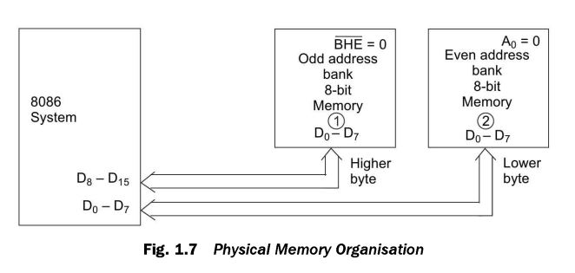
Explanation about this…

Slide 6
The reserved locations of memory for CPU operations
FFFF0H to FFFFF H are reserved for operations including jump to initialisation programme and IO processor initialisation
00000H to 003FF H are reserved for Interrupt vector table
It supports 256 interrupt vectors
For each interrupt service routine it requires 4 bytes. CS:IP
25 interrupts needs 256 * 4 = 03FF H locations (1 Kb) locations for the complete Interrupt Vector Table.

Slide 7
8086 has time multiplexed address and data signals (combined address and data bus)
For maximum utilisation of cpu pins
Demultiplex address and data bus using few latches and transceivers
Processor bus cycle has atleast 4 clock cycles
T1, T2, T3 and T4
Address is transmitted by the processor during T1
T2 - bus is tristated /bus direction is changed for next data read
T3 and T4 - data transfer takes place
TW wait states/ idle states are inserted between T3 and T4 if the device is slow and shows not ready signal
Depending upon MN/ MX -
MINIMUM MODE - T1 - ALE is emitted by processor
MAXIMUM MODE - T1 - ALE is emitted by the bus controller

Slide 8
The negative edge of the ALE is used to separate address and data bus or status information
In maximum mode, status lines S0, S1, S2 are used to indicate the type of operation
S3 to S7 are multiplexed with higher order address bits and the BHE signals
Address is valid during T1 while the status bits S3 to S7 are valid during T2 through T4

Slide 9
IO addressing capability
8086 / 8088 can address upto 64KB I/O byte registers or 32K word registers
Any IO device connected to 8086 can have a maximum of 16 bit address
8086 can access a maximum of 2¹⁶ IO devices
During T1, IO address appears on A0-A15
A16 to A19 are at logic 0 during the I/O Operations
16 bit register DX is used as 16 bit IO address pointer
It can address upto 63Kb IO devices
Memory mapped IO interfacing, IO device address are treated as memory locations
Even address bytes are transferred on D7-D0 and odd address bytes are transferred on D15-D8
For 8 bit io device, all the byte registers in the system should be even addressed

Slide 10
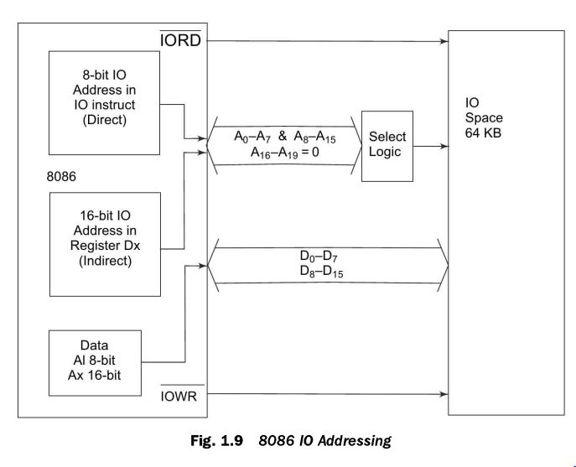

Slide 11
Deriving System Bus
8086 - time multiplexed 16-bit address/ Data bus (AD0-AD15)
Multiplexed 4-bit address/Status bus
Address can be latched using ALE
To demultiplex 20 bit addresses, 3 latches (74373) are required

Slide 12
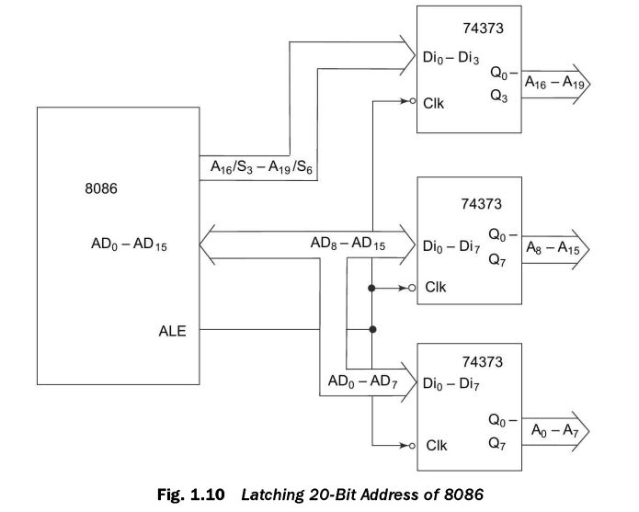

Slide 13
If DEN = low, it indicates that the data is available on the multiplexed bus and both the buffers are enabled to transfer data
When DIR pin is high, the data available at X pins of 74245 are transferred to Y pins
Data is transferred from microprocessor to either memory or IO device(write)
When DIR is low, the data available at Y pins are transferred to X pins
Data is received by microprocessor from memory or IO device ( read)

Slide 14
8086 has 16-bit data bus AD0-AD15
The data can be separated from the address and buffered using 2 bidirectional buffers 74245
Data can be transferred from processor to memory or from memory to processor in case of write or read operations respectively and hence bidirectional buffers are needed for deriving the data bus.

Slide 15
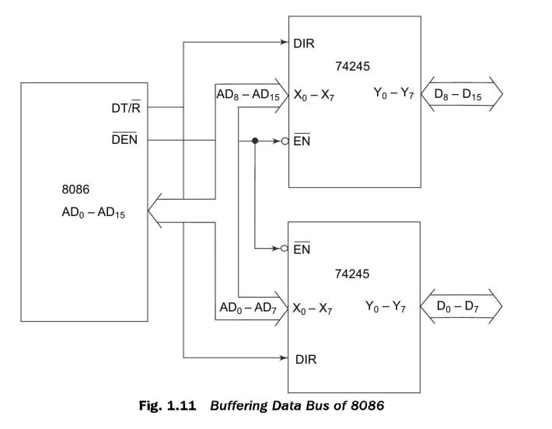

Slide 16
Minimum Mode : Deriving control signals from RD, WR, M/ IO, any combinational logic circuit may be used.
Maximum mode : a bus controller chip derives all the control signals using status signals S0, S1, S2

